Slide 1
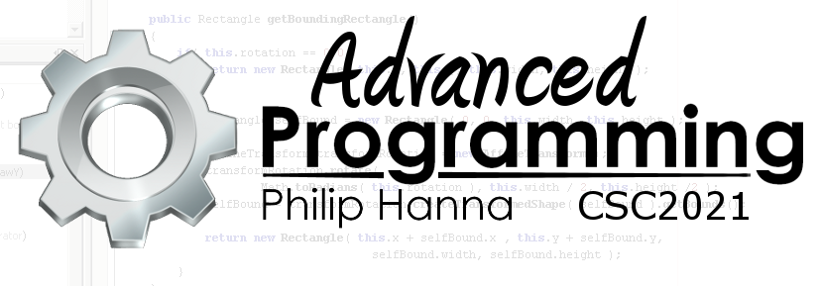
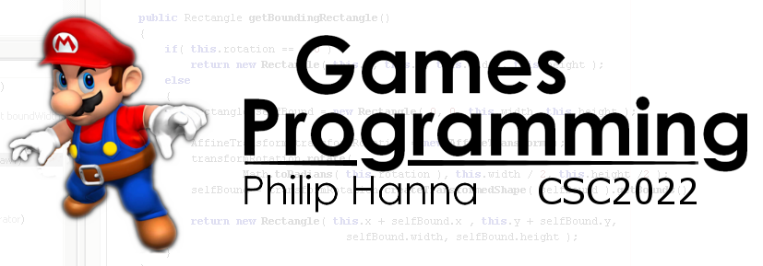
Tactical and Strategic AI
Trying to see and plan for the big picture

Slide 2

Tactical and Strategic AI

Slide 3
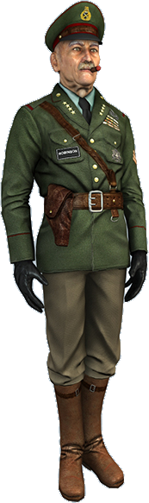
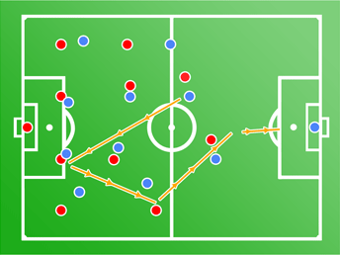
Tactical and strategic AI encompasses a wide range of algorithms that try to:
Derive a tactical assessment of some situation, possibly using incomplete or probabilistic information
Use tactical assessments to make decisions and coordinate the behaviour of multiple characters
Aside: Not every genre of game needs tactical and/or strategic AI

Slide 4



: Waypoint Tactics
C
A waypoint is simply a position in the game world.
As with path-finding waypoints (holding path-finding information, e.g. terrain cost, etc.), tactical waypoints hold tactical information, e.g.:
Cover points
Reconnaissance/sniper locations
Shadowed locations
Power-up spawn points
Exposed locations
S
C
E
R
S
R
C
S
R
P
S
E

Slide 5
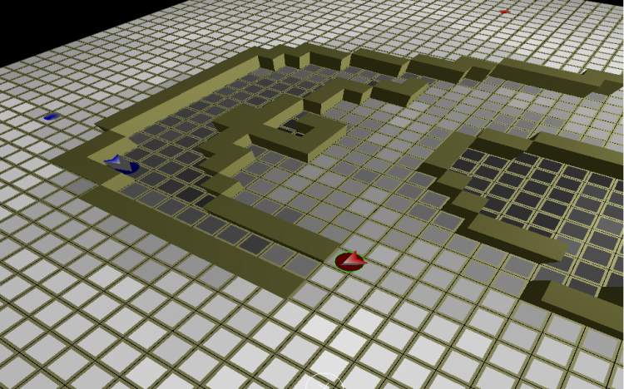
: Tactically Aware Path-finding
Tactical locations can be either set by the designer or derived from game data or analytical algorithms.
Tactical nodes can be combined with path finding nodes to provide tactically aware path finding.

Slide 6
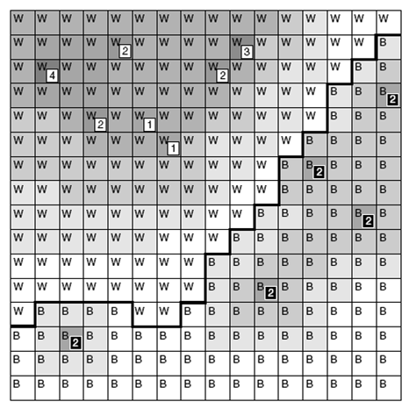
: Influence Maps
Influence mapping is widely used in strategy games to map the influence/strength of each side.
The game world is split into chunks (tile-based is a common representation). Each chunk is assigned an influence score based on the combined balance of influence ‘emitted’ by game objects that can effect that chunk.
The influence map can be used to identify points of weakness and strength and, from this, drive strategic goal selection.

Slide 7

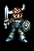
: Influence Maps
1
4
5
4
1
4
The influence exerted on a particular area can depend upon the proximity of objects (e.g. mobile or stationary), type of surrounding terrain (e.g. a mountain range may ‘prevent’ influence passing), side specific factors (e.g. current financial or happiness state), etc.
Influence emitted by an object decays over distance (e.g. using a linear drop-off alongside a defined maximum influence range).
4
4
1
1
3
3
1
2
2
2
2
1
+1
1
1
1
+1
+1
3
3
3
1
1
1
1
2
2
2
4
5
4
3
2
1
1
3
2
4
4
4
2
1
1
1
2
2
3
3
3
3
1
1

Slide 8
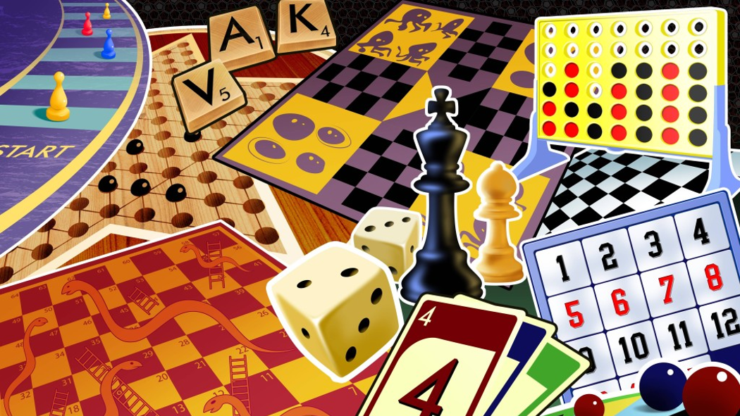
Board Game AI

Slide 9
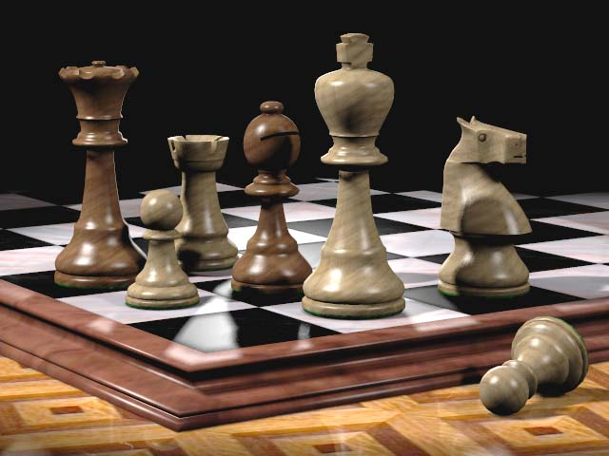
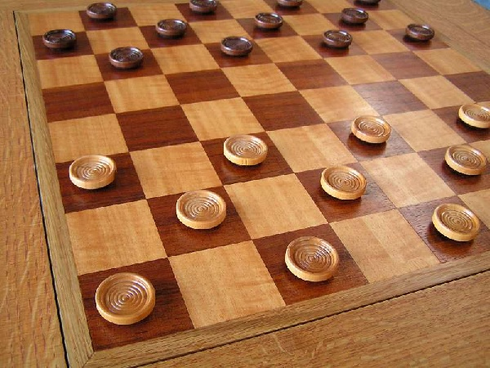
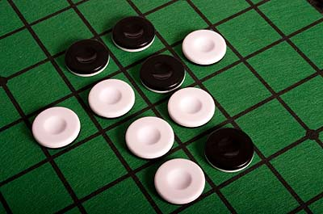
The first applications of AI in computer games was applied to playing board games (e.g. Chess, Tic-Tac-Toe, Go, etc.).
Most board game algorithms assume two-players (but often can be extended to cater for more players). Depending upon the game, players can make moves or take their turn.

Slide 10

: Zero-sum Games
A board game in which the win of one player is equivalent to the loss of the other player(s) is known as a zero-sum game (e.g. chess, but not some casino games where players compete against the house).
In a zero-sum game the focus can be on trying to win or make the opponent lose (the outcome is the same). In a non-zero-sum game, the focus should be on the player winning.
The complexity increases for games with more than two players (even in zero-sum games) as the best strategy may involve temporary alliances against a stronger opponent, etc.

Slide 11
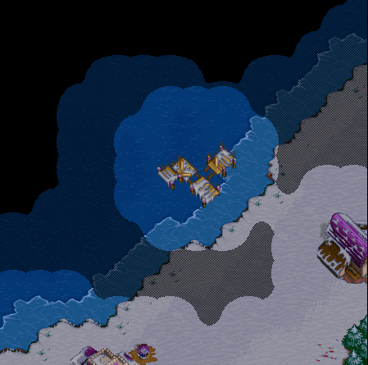
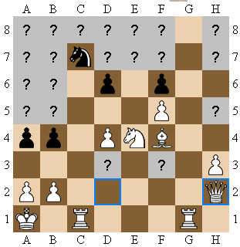
: Perfect/Imperfect Information
In many board games the entire state of the board is known (i.e. nothing is hidden) – known as perfect information.
This entails that every possible move is known and the outcome of that move can also be determined.
Games involving dice rolls or other forms of uncertainty are known as imperfect information.
Aside: Most common board game algorithms are for two-player, perfect information, zero-sum games.

Slide 12
: The Game Tree
O
A game tree represents the game evolution. Each node defines one possible board layout, with each branch representing a valid move.
A terminal node represents an end-of-game state.
Each terminal position assigns a score to each player (e.g. +1 for a win, -1 for a loss, 0 for a draw, or some other numeric measure of the size of win).
In zero-sum games, the total combined score will be zero.
X
...
O
O
X
O
X
X
X
X
X
O
O
O
O
...
O
O
O
...
X
X
X
X
O
X
X
X
X
Aside: The number of branches from each node is called the branching factor.

Slide 13
: Move Evaluation
Aside: In the game of Reversi the best mid-game strategy is to favour moves that minimise the number of own-coloured counters to maximize control (and hence counter count) in the end-game.
In Chess aspects measured within the static evaluation function can include tempo, board control, piece count, etc. Different AI personalities can be easily embedded, e.g. scoring bishops higher than knights, etc.
Board game AI should, given a defined board state, select the best move that is likely to lead towards a win. This is the job of a heuristic static evaluation function which scores a board position from the perspective of one player.
Given a terminal node, the returned score will be the final score for the game. In non-terminal nodes, the score reflects how likely the player is to win from the position (returning an increasing score relative to the strength of the position).
The heuristic function is game specific.

Slide 14
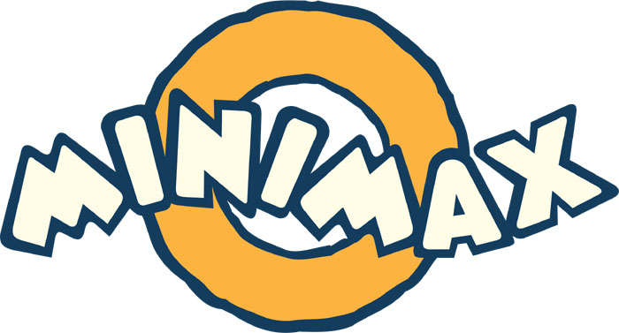
: Minimaxing Approach
The minimaxing approach operates by assuming each move of a player will be to maximize their score, whilst each move of the opponent will be to effectively minimise the player score (assuming a zero-sum game).
Hence the minimax search alternates between maximising the player score on their turn and minimizing the player score on the opponents turn.
By recording the net scores and looking a number of turns ahead the minimax search can then select the best move the player should make.

Slide 15
[Score, Move] minimax(Board boardState, Player player,
int maxDepth, int currentDepth) {
if(boardState.gameOver() || currentDepth == maxDepth )
return [boardState.evaluate(player) , None]
Move bestMove;
float bestScore =
(board.currentPlayer() == player ? -maxScore:maxScore);
foreach( Move move in boardState.getValidMoves() ) {
Board newBoardState = boardState.makeMove(move);
[int currentScore, Move currentMove] =
minimax( newBoardState, player,
maxDepth, currentDepth+1);
if( boardState.currentPlayer() == player ) {
if( currentScore > bestScore ) {
bestScore = currentScore; bestMove = move; }
} else if( currentScore < bestScore ) {
bestScore = currentScore; bestMove = move; }
}
return [bestScore, bestMove];
: Minimaxing Algorithm
Stop the recursion if maximum depth reached or terminal node found
A recursive minimax is defined below, a maximum search depth is used to determine when the search will stop.
Else, find best move
Consider each possible move
Move getBestMove(
Board boardState, Player player) {
[Score score, Move move] =
minimax(boardState,
player, maxDepth, 0);
return move
}
Perform recursion
Update best score depending on if we will maximise or minimise
The code assumes the minimax search returns a best move and score.

Slide 16
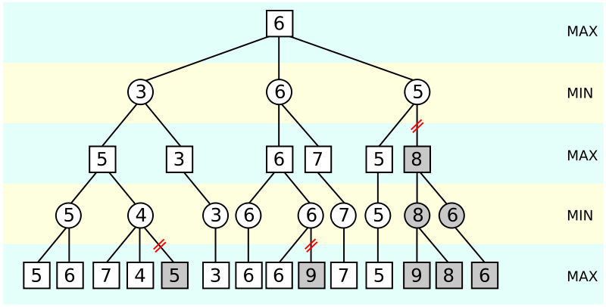

: Other Approaches
A wide range of other techniques can be used within board game AI, including:
Use of alpha-beta pruning (AB pruning) to prune out sections of the search tree that cannot hold the optimal solution
Use of transposition tables to avoid creating duplicate game states and improving search times
Use of opening books and other databases of expert encoded knowledge, including set plays.

Slide 17

Key takeaways:
There are lots of different types of strategic and tactical AI.
Which type of strategic or tactical is selected depends upon the type of game with some degree of customisation often needed.

